Slide 1

DUG Wellness Index 12/14 Status Update
Marvin Smith

Slide 2
Overview
Current Goals / Objectives
Final “Deliverable”
Current Progress / Pretty Pictures
Misc Action Items / Blockers

Slide 3
Current Goals / Objective
Develop Remote-Sensing based solution for measuring the environmental impacts of gardens.
Identify key metrics where gardens help:
Urban Heat Island (UHI) effects: Temperature, Humidity, Air Quality
Identify scientifically-accurate methods of measuring these metrics
Construct a scalable and maintainable workflow for generating results.
Create and maintain a Quick-Look-Report (QLR) with current results
DUG Wellness Index — DUG Wellness Index (marvins.github.io)

Slide 4
Objective Outputs
Land Surface Temperature analysis
Measure spatial variations over the neighborhood. (ex: compare gardens to parks)
Temporal variations (ex: compare gardens and other plots over time)
Water usage of gardens and other plot types
Air Temperature and Air Quality models for select gardens
Comparison of gardens against other neighborhood sensors.
Compare sensors against remote sensing data (Calibration)

Slide 5
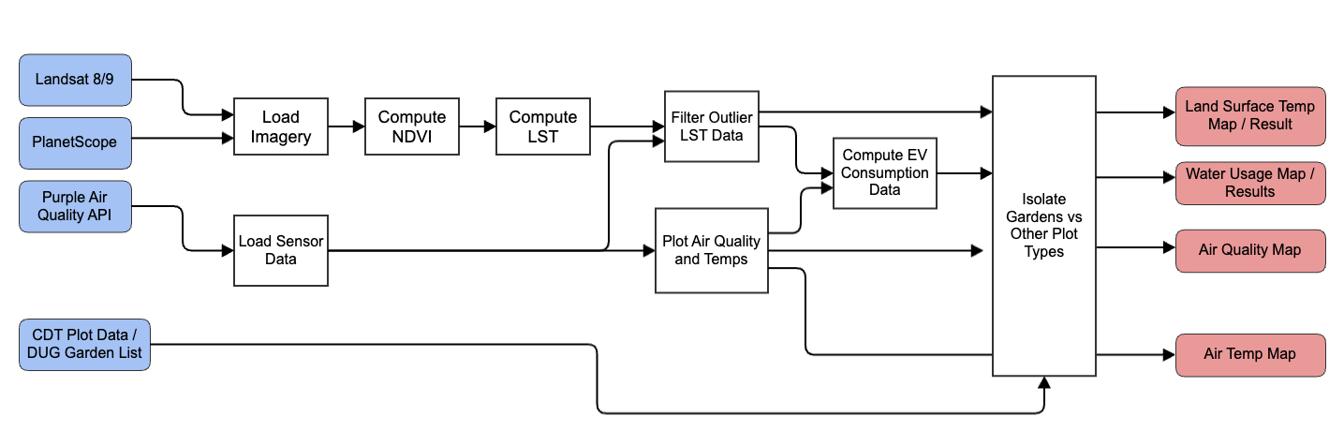
Remote-Sensing Workflow (Current)

Slide 6
Final Deliverable
I owe CU Denver a “deliverable” by Fall 2024
I have no timeline long-term, but I want to give them a chalk-line.
I propose the following:
Paper / report publishing my findings:
What impacts do urban gardens have on the environment w.r.t. water, temperature, and air quality?
How do gardens compare to other plot types?
What other interesting things do we find with this data?
2. Presentation with lots of pretty pictures
3. Workflow documented, enabling DUG’s eventual Data Scientist to easily create a dashboard.
All code is currently published to GitHub:
marvins/DUG_WellnessIndex: Documentation for how I compute DUG Wellness Index (github.com)

Slide 7
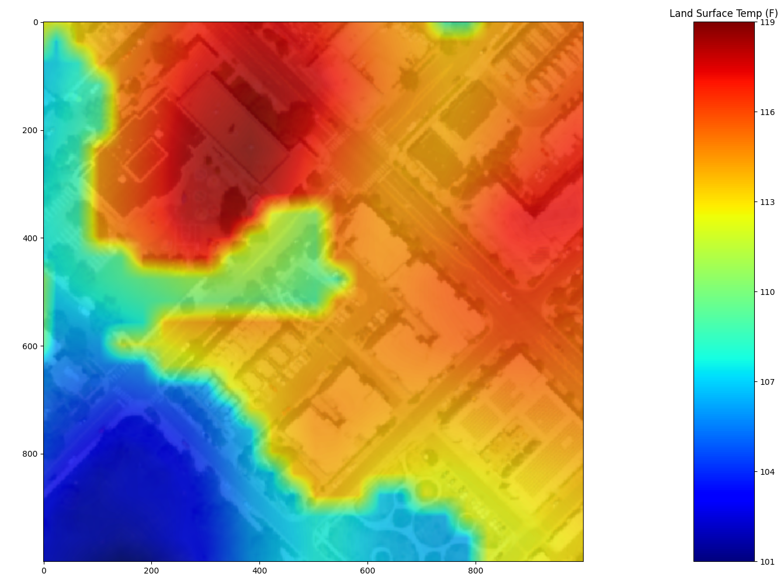
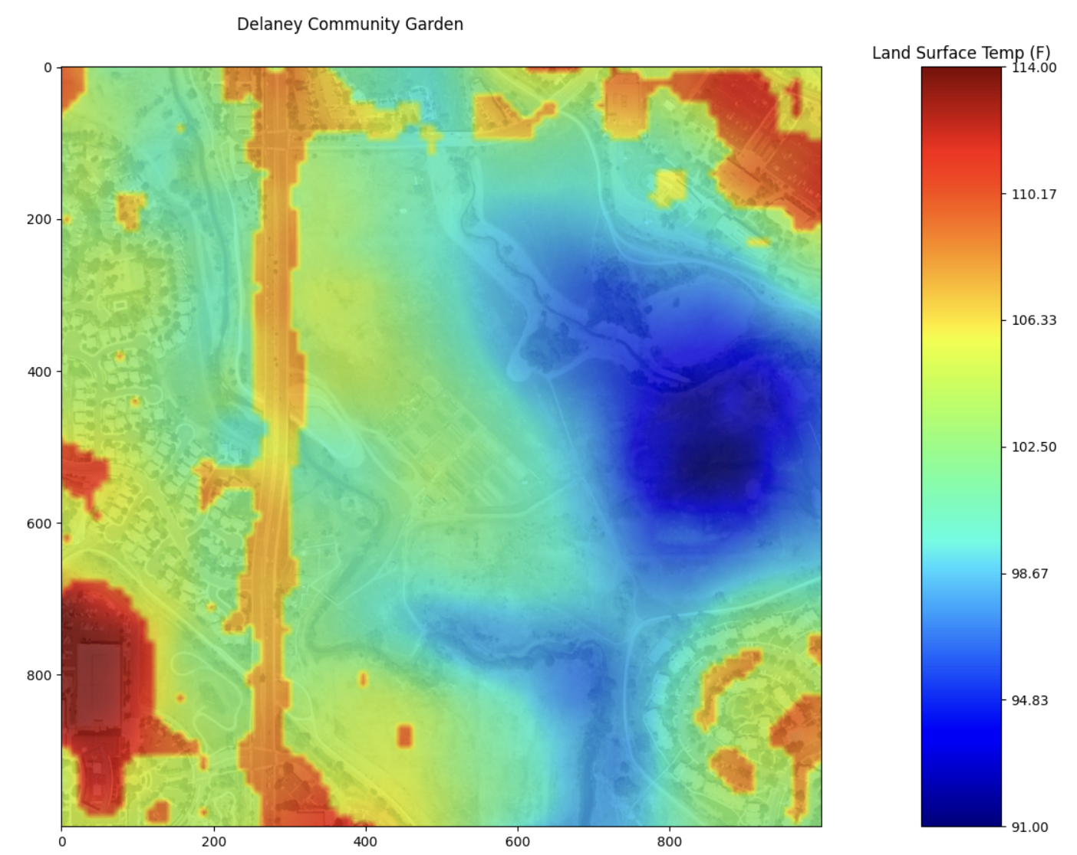
LST and NDVI can now be computed
Landsat 9, Aug 12, 2023, City Lights Garden
Delaney Community Garden

Slide 8
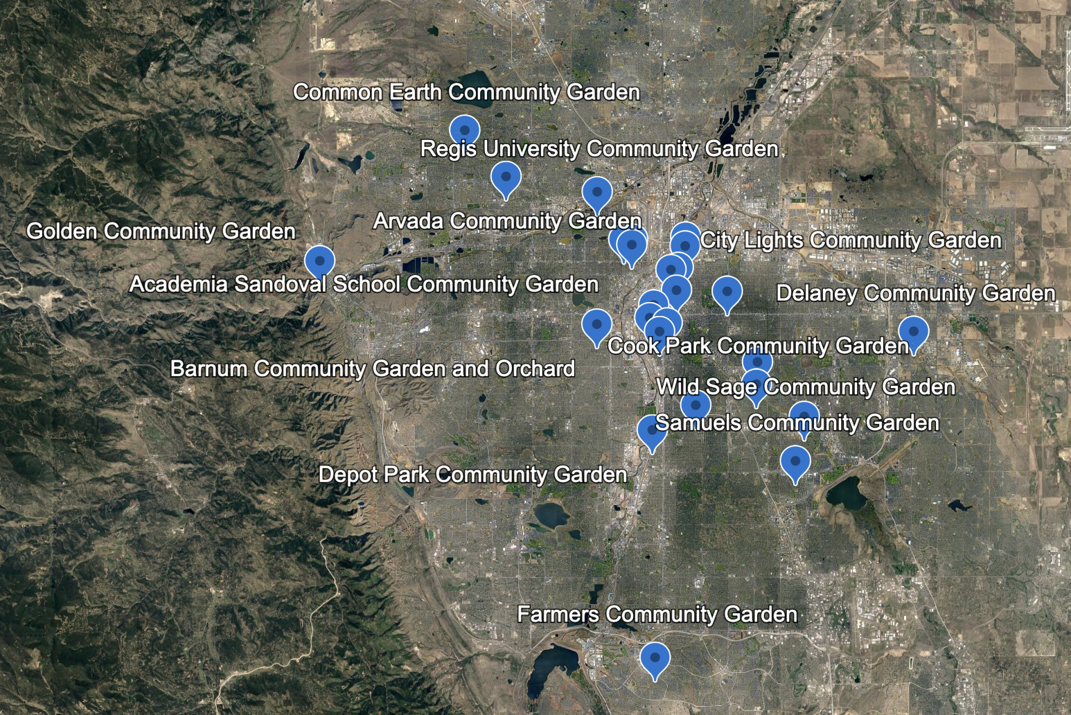
Current Garden List is Usable
Eventually will need full list, with preferably dates when the gardens were founded.
Time-series analysis will be very interesting.

Slide 9
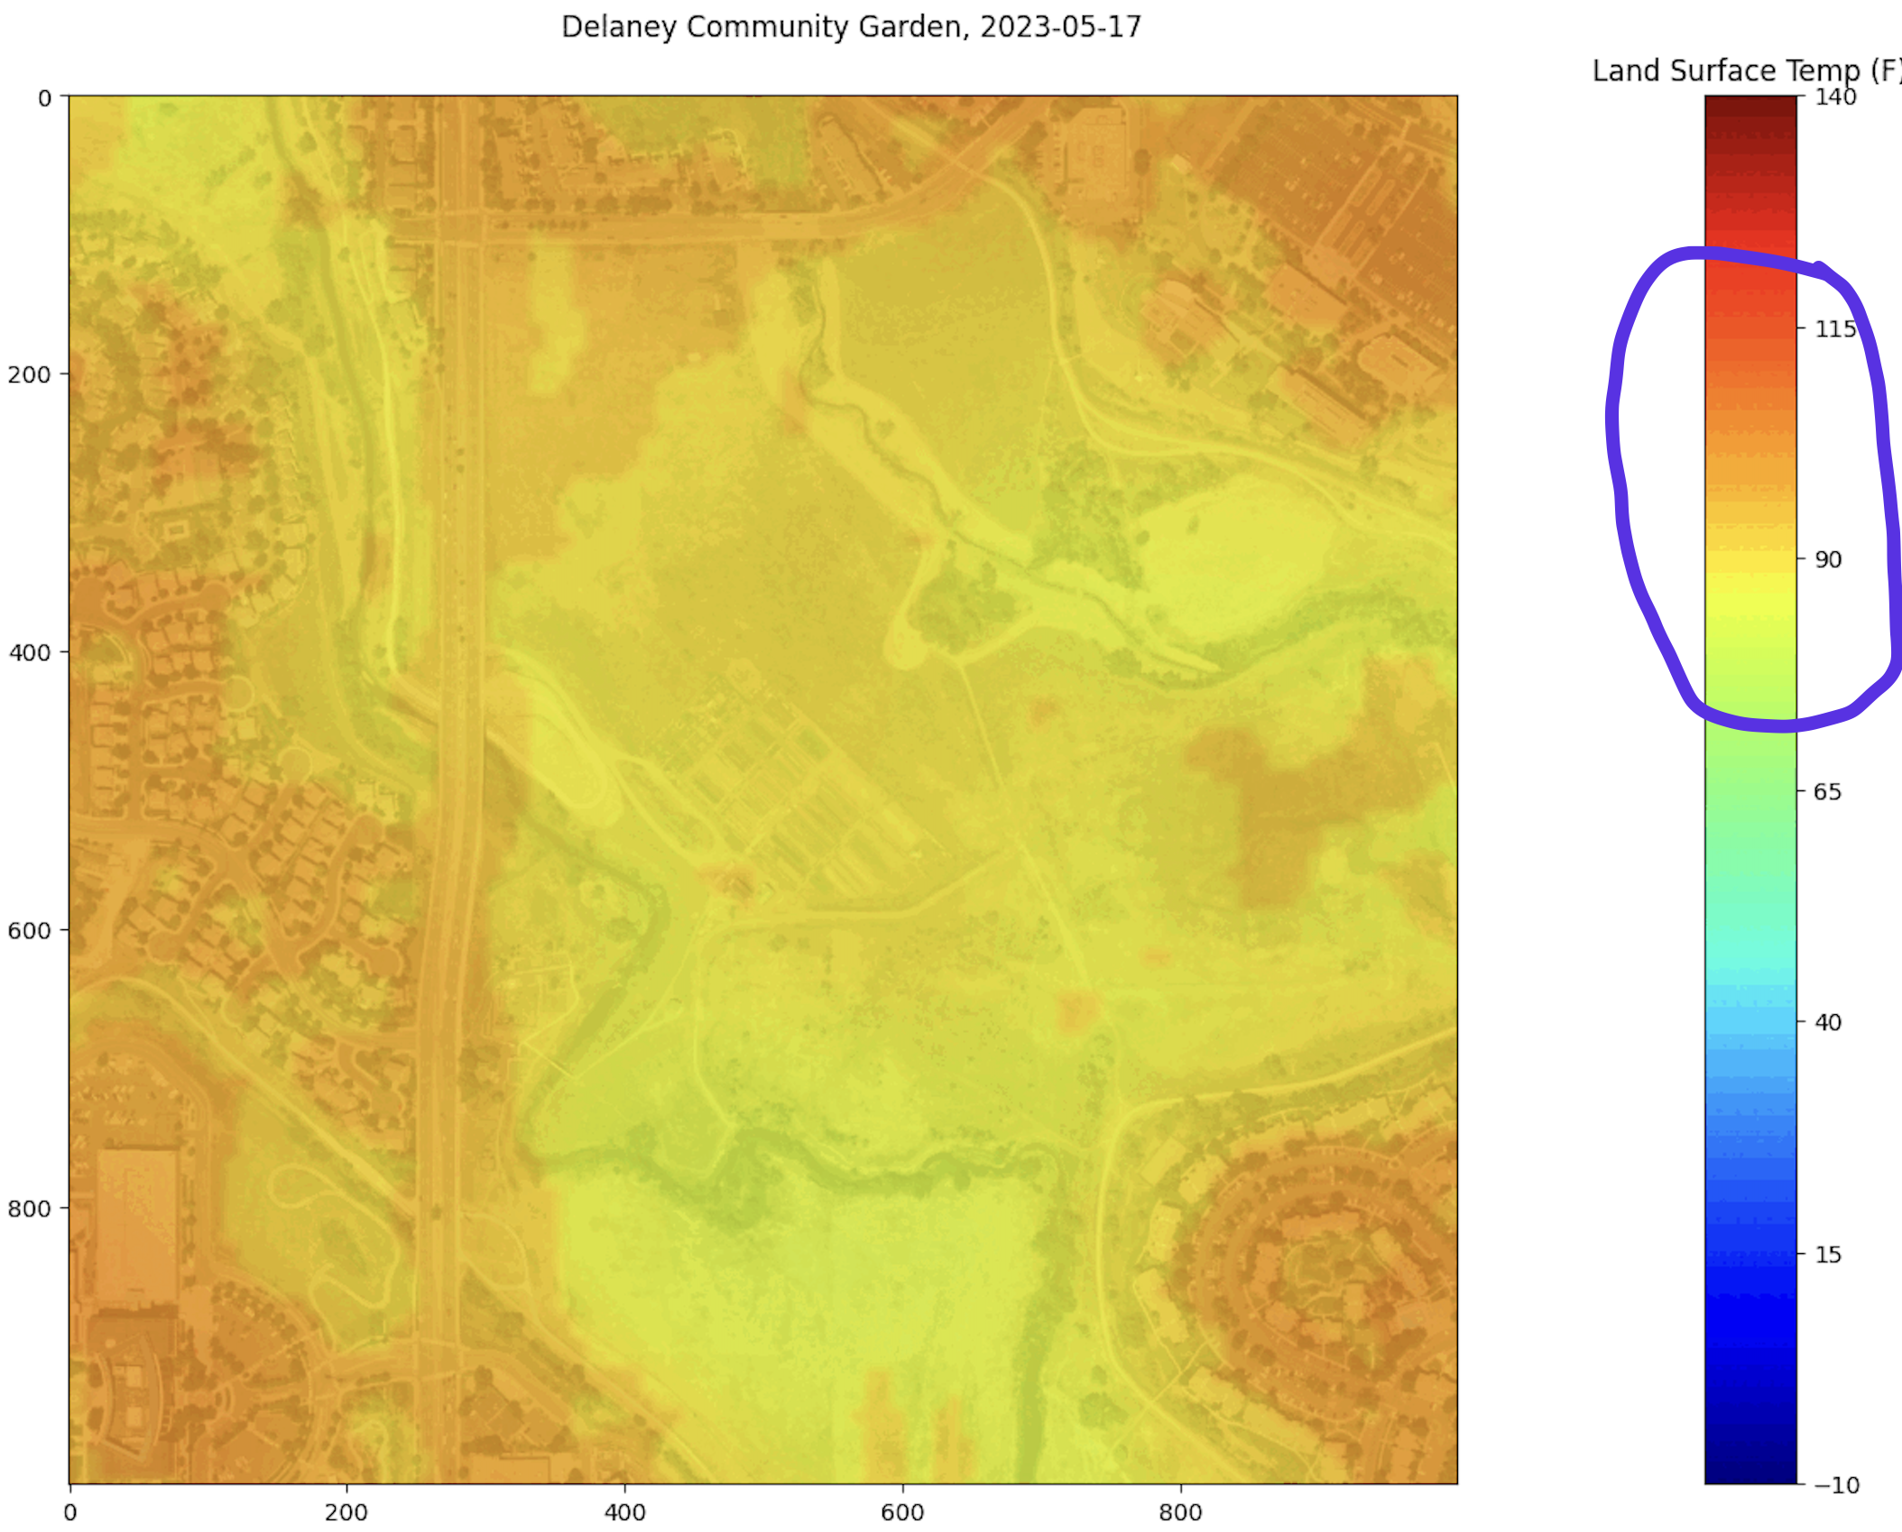
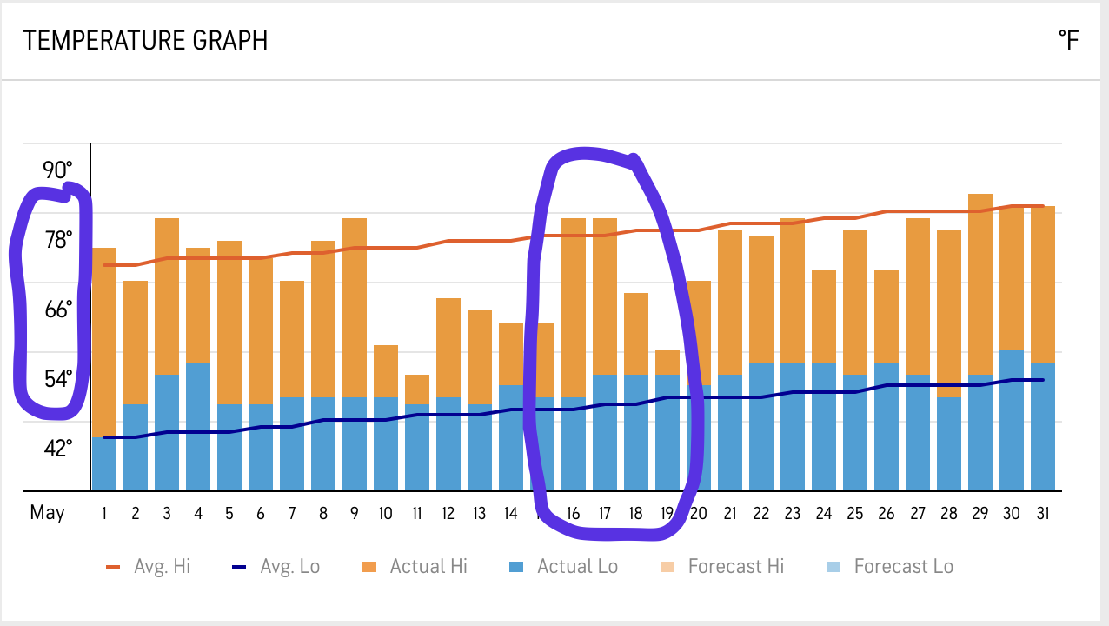
Current Issues
Temperature accuracy can be hit or miss
Seems like cloud cover or other attributes creating discrepancies.
Need alternate data source to provide reference.
Purple Sensor API
PlanetScope

Slide 10
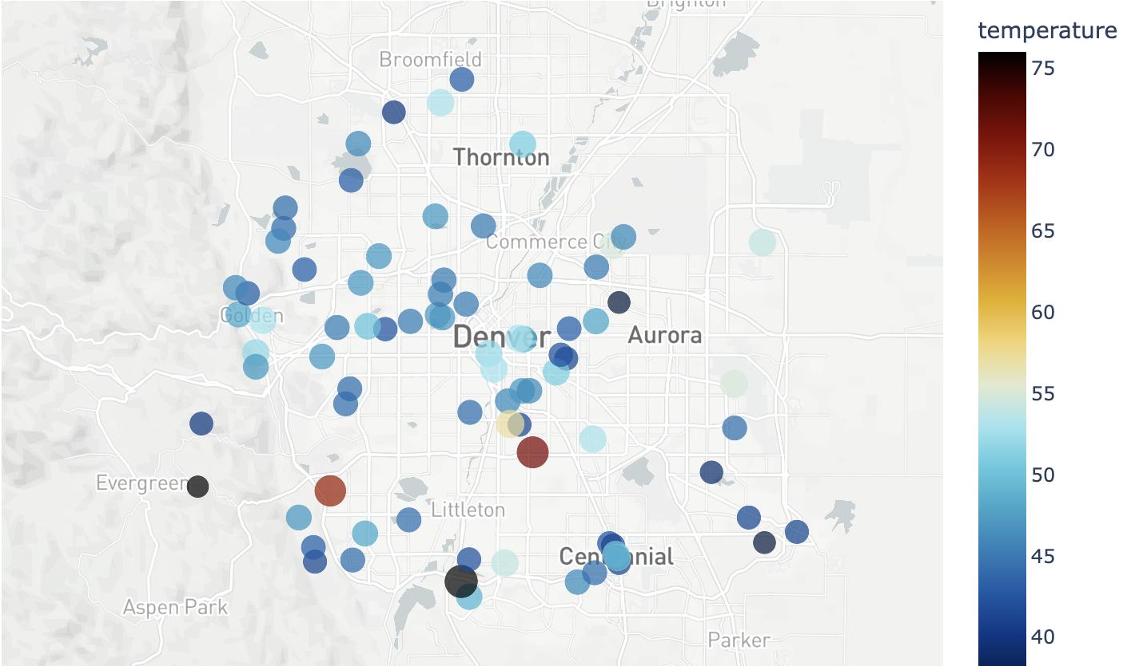
Purple API Sensors
Pretty good coverage throughout Denver.
Historical data cheap to obtain.
Temperature, humidity, AQI (multiple types of particulates), and other metrics available.

Slide 11
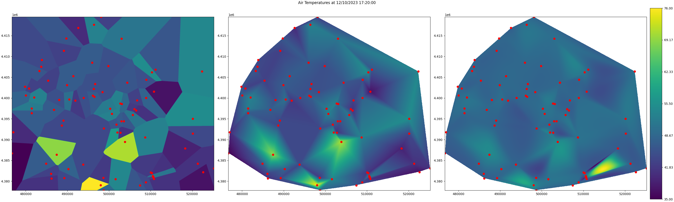
Building Heat Raster From Sensor Temps
Making progress converting Purple Sensor API data into usable map data.
- Need more sensors, plus need to filter out bad results
- Currently focusing on the mechanics of using the data.
Interpolation for creating heatmaps.
(Nearest)
(Cubic)
(Linear)

Slide 12
Imagery Action Items
Looking at methods to estimate cloud cover from Landsat imagery
Landsat provides band 9 (1.36-1.38mm wavelengths), which heavily reflects clouds.
USGS provides some pre-computed data already I’m learning how to read as well.
Need to continue finding root causes of bad Landsat LST measurements
Need method to create LST measurements for small region and start building time series plots
Need to expand Landsat dataset to span multiple years. Each file is 1GB, so a moderate 5-year dataset will run about 600GB. I’m working on optimizing this.

Slide 13
Air Sensor Action Items
Need to continue development of air temperature, humidity, and AQ overlays
Need to build database of sensor data.
Need to correlate air-sensor data against remote-sensing data to find relationships.

Slide 14
Other News
I applied, and was approved, for Planet Corporation’s Research Program. This gives people supporting educational or nonprofit organizations with access to Planet imagery for 2 years.
This will give us access to data with 10x better resolution than Landsat.
Still working on access for data downloads and basemaps.

Slide 15
Misc Action Items
Waiting on response from Dr Crawford regarding some questions about evaptranspiration.
Need to estimate water usage from imagery or other source.
Some algorithms do provide this, but I’m unfamiliar with them (SEBAL).
Still reading a lot about this science. I’ll be at this for a while.

